Slide 1
CSE 315
Subject : Sound Sensor
Submitted To:
A.S.Zaforullah Momtaz
Assistant Professor,CSE
UAP
Submitted By:
Labanya Saha
Reg No:21201059
Roll No:59
Sec:B

Slide 2
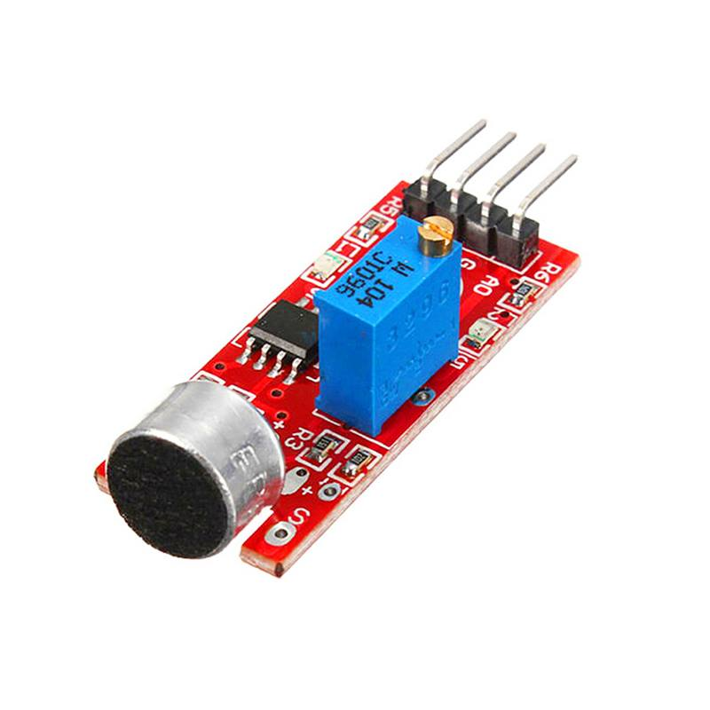
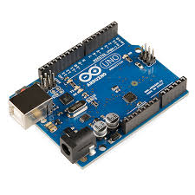
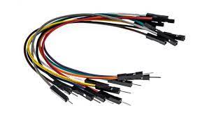
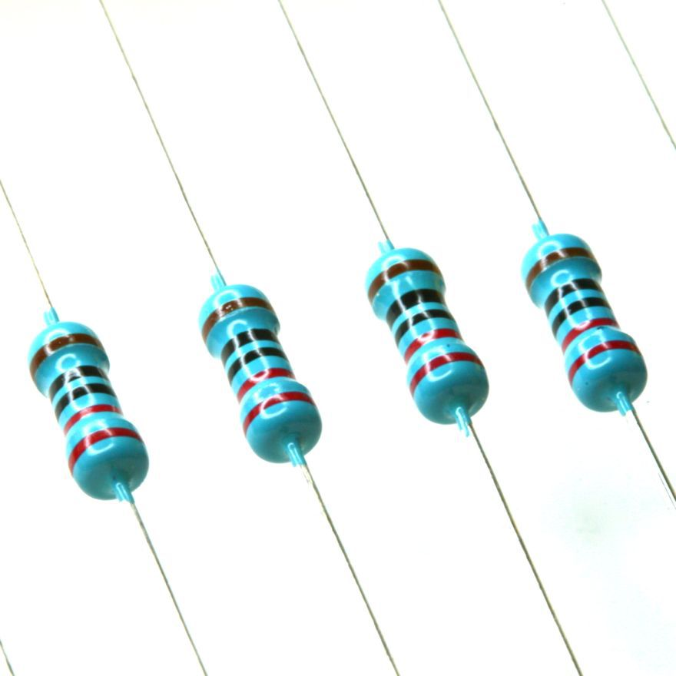
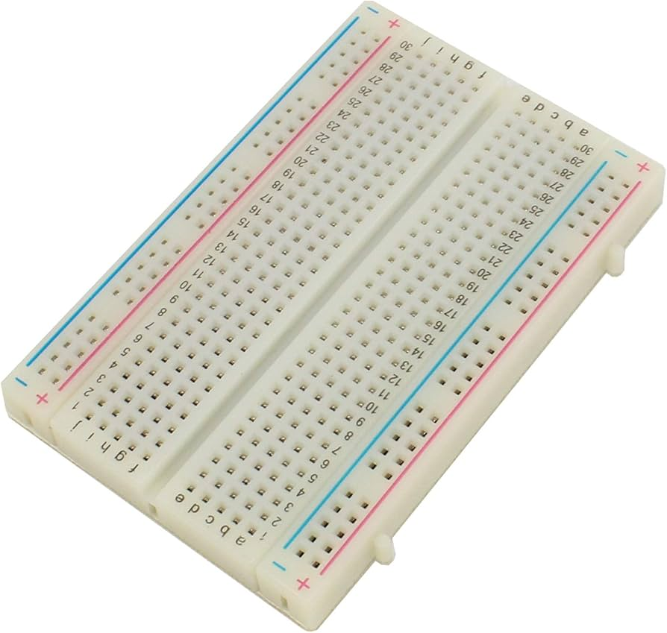
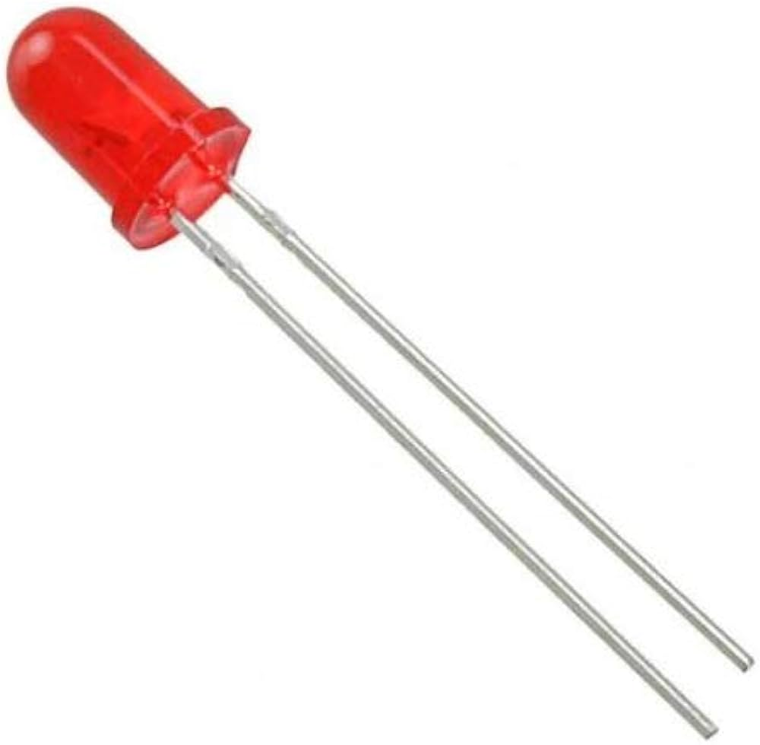
Components:
*Arduino Uno
*Microphone Sound Sensor
*Breadboard
*LED
*220Ω Resistor
*Jumper Wires
Fig 1: Michrophone sound sensor
Fig 5:Jumper Wire
Fig 2:Arduino UNO
Fig 3:Bread Board
Fig4: Led
Fig:220Ωresistor

Slide 3
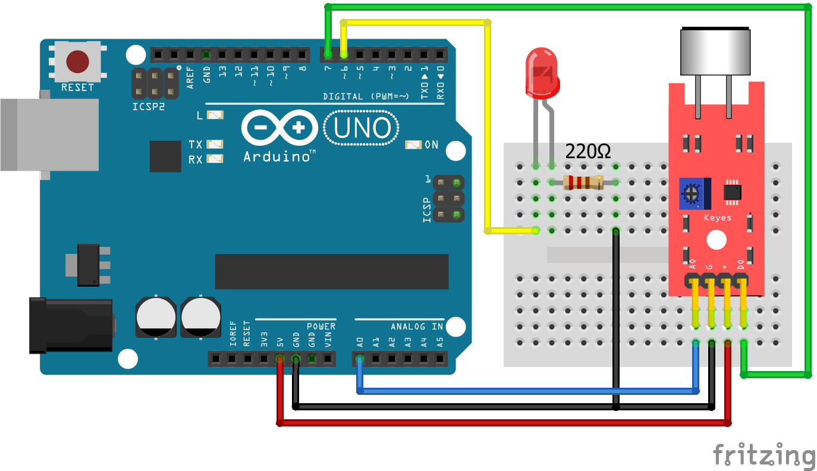
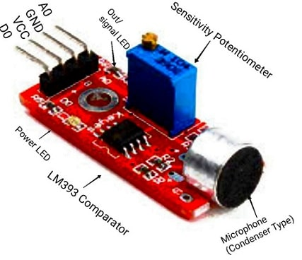
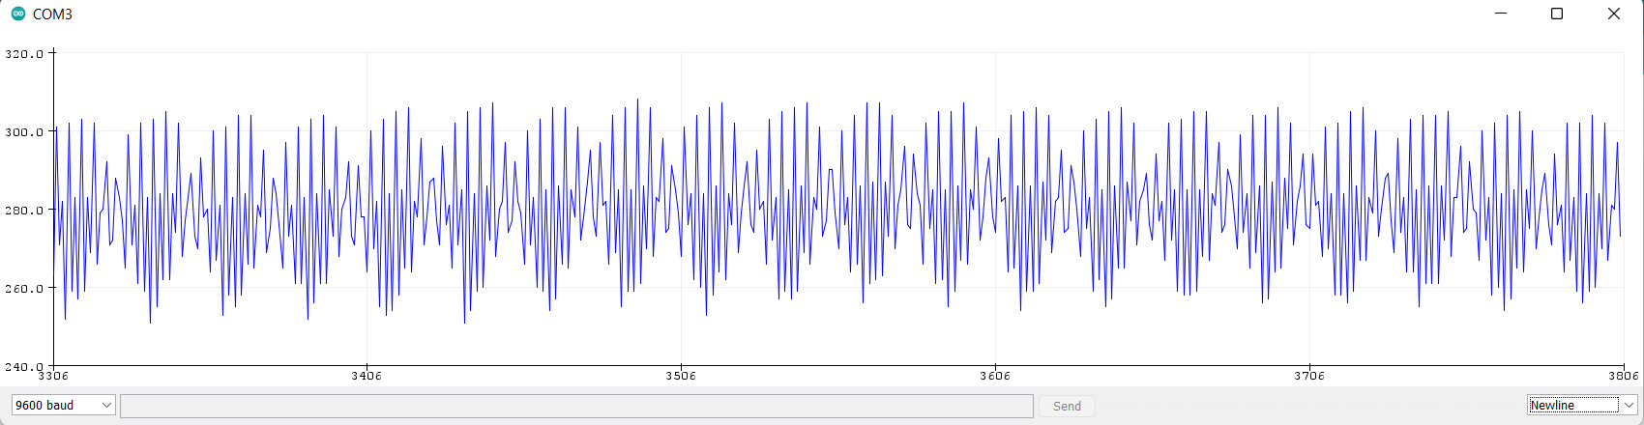
It’s application
Connect with Arduino
Sound Wave
A sound sensor works by detecting sound waves (vibrations in the air), converting them into an electrical signal that can be measured or processed.

Slide 4
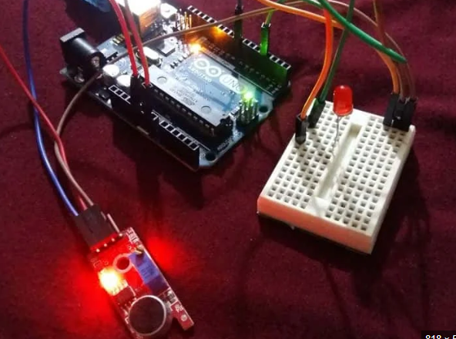
Sound Detection: The sensor picks up sound waves through a microphone or piezoelectric element.
Signal Conversion: The sensor converts the sound waves into an electrical signal.
Output: The sensor sends either an analog signal (representing sound intensity) or a digital signa
l (HIGH/LOW based on a threshold) to a microcontroller or other device
Int ledpin=13;
Int sensorPin=7;
Boolean val=0;
void setup (){
pinMode(ledpin, OUTPUT);
pinMode(sensorPin , INPUT);
Serial.begin (9600);
}
Void loop(){
Val = digitalRead(sensorPin);
Serial.println(val);
If(val==HIGH){
digitalWrite(ledpin, HIGH);
}
else{
digitalWrite(ledPin, LOW);
}
When the sound sensor detects sound, it converts the sound waves into an electrical signal. If the signal is strong enough (above a set threshold), the sensor sends a HIGH signal to a microcontroller, which then triggers a specific action (like turning on an LED or a motor).

Slide 5
THANK YOU

